Slide 1
De kinderspelen

Slide 2
Target Group
Audience?
Experience of user?
Goal?
Childere / Educational/fun

Slide 3
Position/role
Static position (center of room)

Slide 4
Type of immersion
Spatial immersion
Why?
Type of immersion: Spatial immersion (because you start in the museum itself and explore the games in the museum)

Slide 5
Moodboard

Slide 6
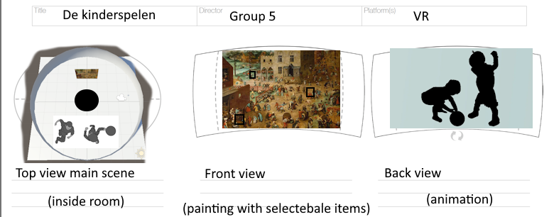
360 map of main scene

Slide 7
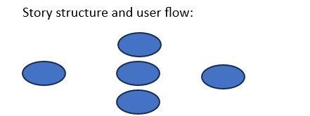
Story structure and user flow

Slide 8
Storyboard
Tekst hier?
Storyboard: Find wand, aim to painting, painting come to life

Slide 9
End
Naar huis!

